Slide 1

Outliers
By Asma Qaiser

Slide 2
What is outlier?
An outlier is a data point that is noticeably different from the rest.
It can be either much higher or much lower than the other data points.
Outliers can have a significant impact on the results of statistical analyses and machine learning models.
They can be caused by errors in data collection or represents genuinely rare events.
E.g: Sultan Kösen from Turkey. He is 8 feet 2.8 inches tall.

Slide 3
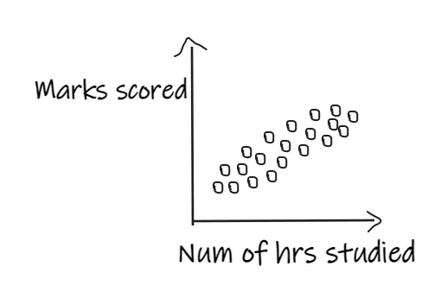
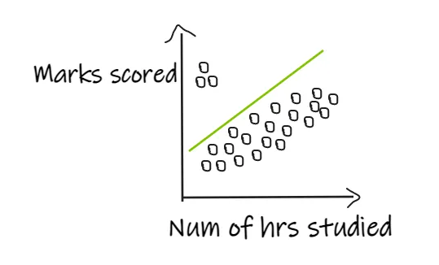

Slide 4
Outlier Detection and Removal
Z-score Treatment
IQR based filtering
Percentile
Winsorization
Outlier Treatment
Trimming
Capping

Slide 5
Outlier Treatment
Trimming:
Trimming involves removing the outliers from the data set.
Capping:
In this method, the outlier data points are capped with the highest or lowest values

Slide 6
Outlier Detection Methods

Slide 7
1. Z-score Method
The main assumption in this technique is that the data should be normally distributed or close to normal distribution.
If the data is normally distributed, the Empirical Rule says that 68.2% of the data points lie in between the 1st standard deviation, 95.4% of the data points lie in between the 2nd standard deviation, and 99.7% of the data points will be between the 3rd standard deviation.
Data points that lie outside the 3rd standard deviation can be treated as outliers.

Slide 8
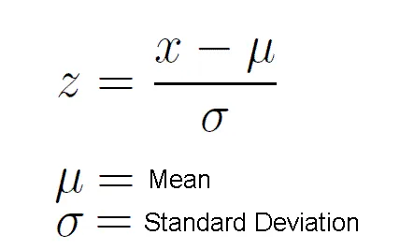
1. Z-score Method
Any data point with an absolute Z-score greater than the threshold (-3,3)is considered an outlier.
These data points are significantly different from the rest of the data and may warrant further investigation.

Slide 9
How to treat outliers
Data is missing completely at random.

Slide 10
1. Z-score Method
The Z-score method assumes that the underlying distribution of the data is approximately normal (Gaussian).
This means that the data should follow a bell-shaped curve with a symmetric mean and standard deviation

Slide 11
When to use this Method?
When data distribution is normal.

Slide 12
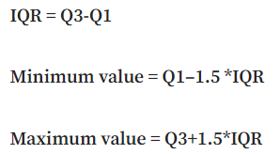
2. IQR technique
This method is used when the distribution of the data is skewed.
The IQR describes the middle 50% of values when ordered from lowest to highest. To find the interquartile range (IQR), ​first, find the median (middle value) of the lower and upper half of the data. These values are quartile 1 (Q1) and quartile 3 (Q3). The IQR is the difference between Q3 and Q1.

Slide 13
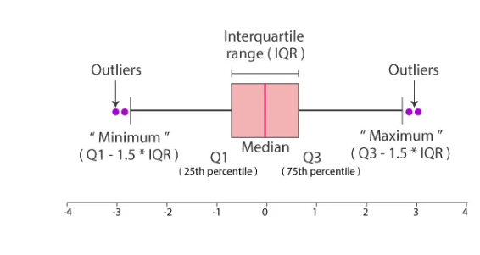
2. IQR technique
The data points which are lesser than the minimum value and the data points which are greater than the maximum value are treated as outliers.

Slide 14
3. Percentile Method
In simple words, Percentile can be seen as the value below which a percentage of data falls. If my score is 90 percentile, then that means my score is better than 90 percent of the students who took the examination.
If you scored the maximum score, which happens to be 95, then it is 100 percentile, which means you scored more than the 100% of the students who took the examination.
This is one of the simplest techniques used to detect the outliers in a dataset. We need to just decide the threshold, Eg, if we decide 1 percentile, then it means we treat all the values above 99 percentile and below 1 percentile as outliers.

Slide 15
Winsorizating
winsorizing involves replacing them with the nearest non-outlier values.
“Winsorizing” retains the responses in your basis but caps numeric outliers so they fall at the edge of the main distribution. A common request is to bound the data to the [5%, 95%] percentiles.

Slide 16


